Slide 1
Lending Club Case Study
By Ch R Srutha Keerthi Kanchanapalli

Slide 2
Problem Statement
When the company receives a loan application, the company has to make a decision for loan approval based on the applicant’s profile.
Two types of risks are associated with the bank’s decision:
If the applicant is likely to repay the loan, then not approving the loan results in a loss of business to the company
If the applicant is not likely to repay the loan, i.e. he/she is likely to default, then approving the loan may lead to a financial loss for the company
Given a dataset which contains past loan applicant's details we have to identify the pattern of default customers. So that lending company can take well informed decision to mitigate losses

Slide 3
Data Cleaning
Rows: 39717 entries Columns: 111 entries –Before data cleaning
Rows: 36431 entries Columns: 54 entries –After data cleaning
So 8.27% of observation lost in data cleaning
Defaulted loans percentage - 13.57%
Fully Paid loans percentage - 83.51%
Current loans percentage – 2.93%

Slide 4
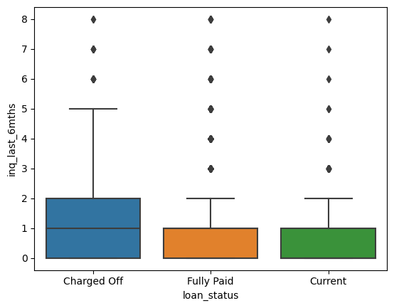
Obsevations
More the no.of inquires made in last 6months chances of default is high

Slide 5
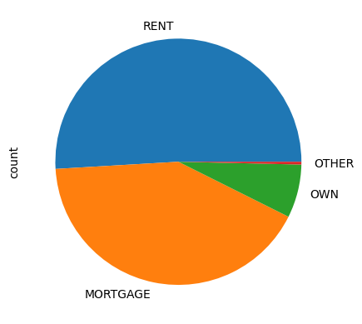
Obsevations
Applicants with home ownership as rent and mortgage are more likely to default than with own house

Slide 6
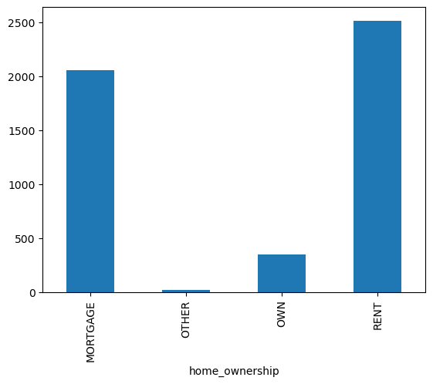
Obsevations
Rent and mortgage applicants who defaulted made more inquiries than own house applicants

Slide 7
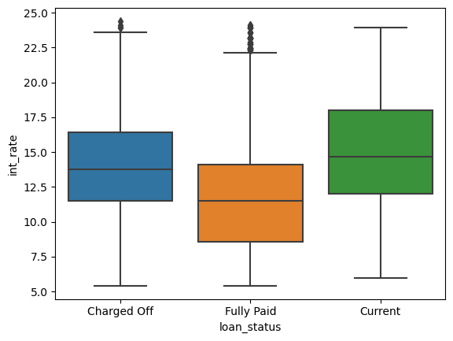
Obsevations
Chances of default high with high interest rates

Slide 8
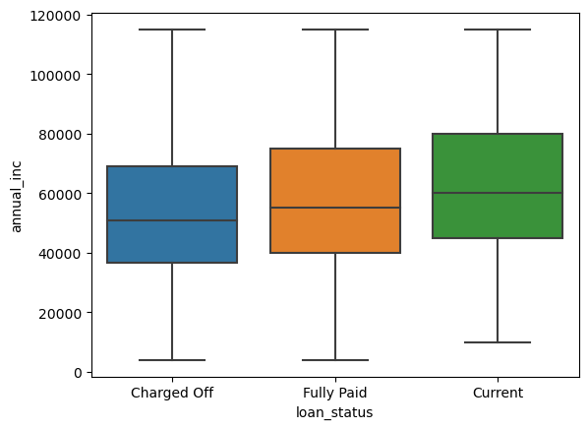
Obsevations
More annual income less chances of default

Slide 9
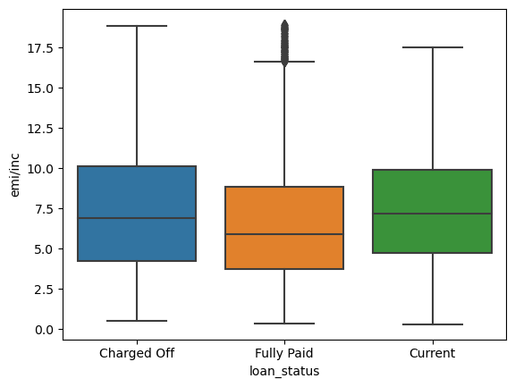
Obsevations
More the EMI per monthly income chances of default is high

Slide 10
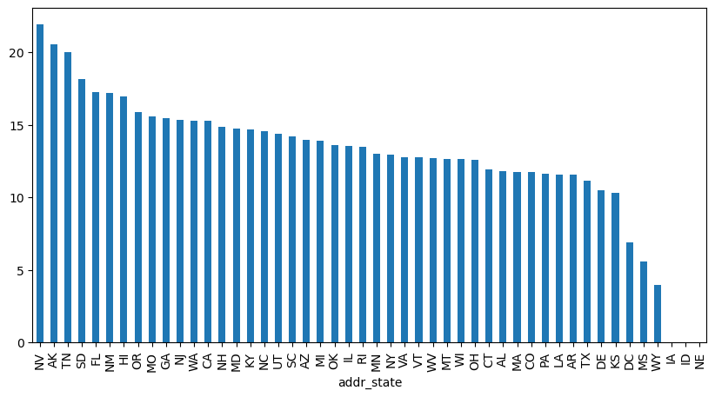
Obsevations
States in the order of high default percentage

Slide 11
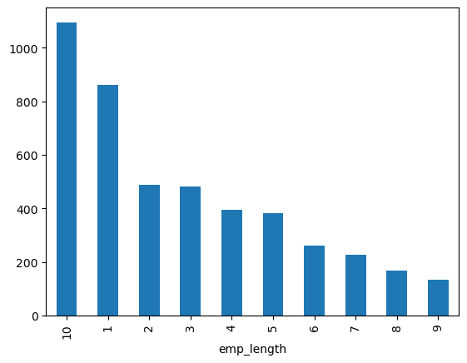
Obsevations
Employee tenure is more chance of default is less

